Slide 1
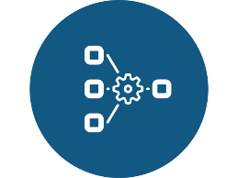

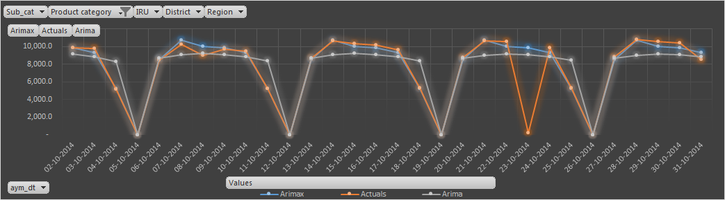

Daily Demand Forecasting- Service Orders for Operational Planning
Methodology
Output
Data Preparation
Exploratory Data analysis
Forecasting & Validation
Data
2 – Year Historical Daily Level Call Data
Segmentation
Zip code, Product Category, Payment Method
Techniques
Applying ARIMA, Neural Networks, ETS, ARIMAX
Business Objective
LatentView Solution
Business Benefits
Client is one of the largest retailer who provides End-to-End solutions including after-sales services
There is a fluctuating demand pattern for Service Orders on daily basis. The client wants Daily Demand forecasts to:
Avoid over-staffing, and
Allocate resources optimally with least Response Time
Classify the Historical data by Geography, Product Category, Customer types
Run Modelling using different techniques: ARIMA, ARIMAX, ETS, Neural Networks
Use the best results based on the overall accuracy of the model generated
Deliver the forecasts for the next 18 Months, at a daily level
Enables to analyze the patterns and seasonality of demands at a deeper level
Optimal supply of Technicians helps reduce the cost of overstaffing
Helps to plan for specific- Geography, Product Category and Customer Types
Used in budgeting, planning and procurement of resources
1

Slide 2



Inventory Metrics Measurements and Reporting for a leading Beverage Company
Methodology
Levels of Granularity
Sector/Sub Sector/Country
Material Attributes
Business Segments
Brands
SKU
Identifying Insufficient and Excess Inventory
Set and Refresh Inventory Targets
Analysis of Improvement Scenario
Supply Chain Health
Inventory Analysis
SKU Analysis
Component Overview
Safety Stock Analysis
Cycle Stock Analysis
In Transit Analysis
Pre-Build Analysis
Scenario Analysis
Goal Setting Analysis
What-if Analysis
Business Objective
LatentView’s Solution
Business Benefits
To provide a starting point for the analytics dimension of inventory management capabilities
To identify average excess inventory levels and set smart targets by SKU and location
To identify ‘near term’ inventory reduction opportunities
To understand key operational drivers
Dashboards were built using Tableau to provide an end to end solution illustrating the flow of Inventory for both Raw Materials and Finished Goods
A logical flow of dashboards was built which provided a holistic snapshot of the supply chain network , capturing the key governing parameters from a sector level to an SKU level
Developed a What-If analysis framework providing the user a platform to simulate different scenarios and hence identify the optimal method to reduce excess inventory.
Provides better inventory planning in the warehouses thus reducing the cost of carrying goods and also avoid stock-outs
Identifies the opportunities for improvement from a Sector level up to a SKU location level using the key performance indicators for various inventory components

Slide 3
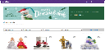
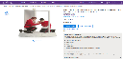
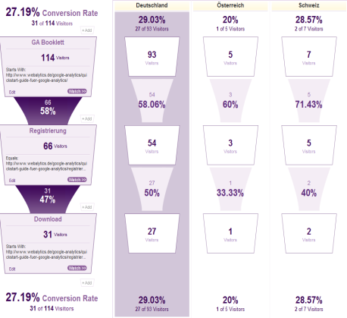

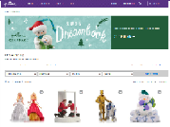
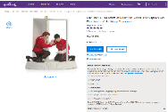
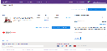
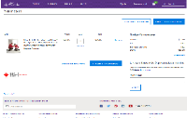

Consumer Insights- Online consumer path analysis
Methodology
Data Preparation
(Identify sequence of pages leading to a Transaction)
Dominant Path Identification
(using statistical techniques like Markov chains and Levenshtein distance measure)
Reverse Funnel Analysis
(Identify reasons for drop off on the dominant path at an overall as well as Segment level)
Findings & Recommendations
Business Objective
LatentView Solution
Business Benefits
An e-retailer wanted to:
Understand different purchase journey paths in an Omni-channel context
Identify points of influence for different purchase journeys
Understand the roles of Social, Digital, Email marketing, etc.
Build the path to purchase visualization landscape by mapping information from different nodes in the purchase journey
Measure and analyse channel effectiveness and role in overall purchase ecosystem
Predict and attribute role of the points of influence to purchase funnel and complete the path to purchase understanding
Analysis gave an opportunity to study online consumer behavior in order to optimize consumer experience and increase revenue and earnings.

Slide 4
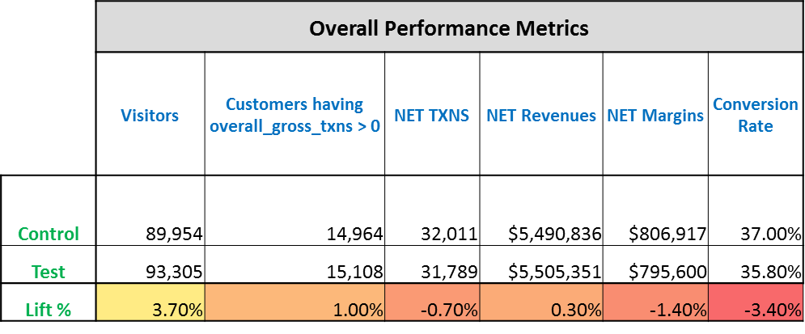
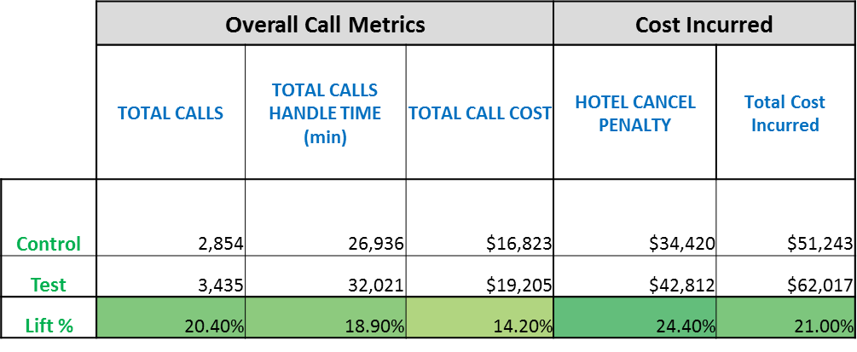
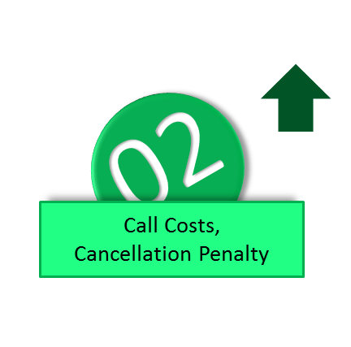
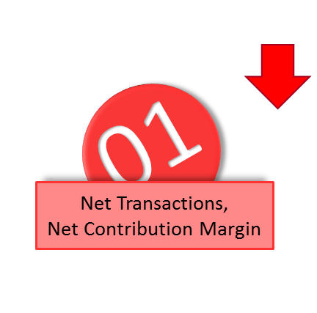
Revenue Management- Rewards Program Analysis
Insights
“ Client incurred close to $2.5 million due to customers abusing the existing rewards program.”
“ Scraping of the existing Loyalty program in a phased manner till coming up with new one”
Business Objective
LatentView Solution
Business Benefits
Client has been incurring huge expenses because of the existing Loyalty program
Measured the monetary impact of enabling/disabling the Rewards Program
Stratified Sampling was performed on the eligible set of customers (for Loyalty Program) to arrive at a test & control sets.
Provided Loyalty Program features & benefits to Test group for couple of Months
Pre – Post period revenue numbers and the corresponding cost incurred by the test and control groups were analyzed.
Client would be scraping the Rewards Program for all customers in a phased manner from October 1, 2015.
Immediate savings due to program shutdown to the tune of $500k in call-centre costs.
Long Terms Savings to the tune of $2 million as Client wouldn’t have to pay Cancellation Penalties to the Vendors.

Slide 5


Pricing Optimization
Methodology
Data Preparation
K-means Clustering
Linear Regression
Teradata
R
Optimization Tool
Sample Result
Business Objective
LatentView Solution
Business Benefits
Client is a retail giant based out of USA and Canada.
Maximize the total portfolio margin by varying the prices of different products across different brands.
Understand the elasticity of all the products under a division.
LatentView adopted the K-means clustering to group similar products with in competition. Linear regression was used to model for each brand.
A tool was created in excel in order to help the client understand the relation between price and demand. The client can vary the prices and find the change in demand and margin.
Helped the client to understand the major competitors to the home brand within a cluster from cross price elasticities.
Helped the client to understand the cannibalization of home brand products among themselves.
Helped the client to maximize the margin as a result of change in prices.
5

Slide 6
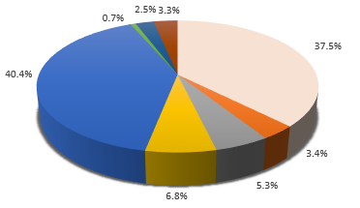
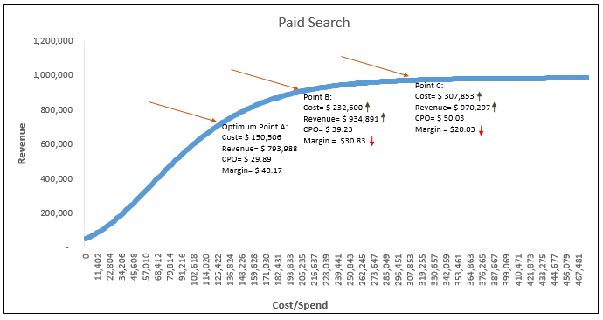
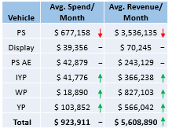
Marketing Spend Optimization- Media Mix Modelling
Insights
Redistribution of Revenue
Optimal Spends across Channels
Reallocation of Budget
Sample Results
Business Objective
LatentView’s Solution
Business Benefits
The Client is a leading home appliances and repair services provider and needed an analytical solution to develop a media strategy in the digital space. The repair market was the key target area
The objective was to optimize marketing spend by allocating dollars to different marketing channels in order to maximize revenue
LatentView built a regression model for different channels using clicks as IDV to determine the equation that best defines the relation
Solution included finding optimized spends across all channels
The data was then analyzed and various Key insights and Recommendations were presented
The Marketing team could use the predictive models to optimally allocate budgets to maximize ROI
Seasonality trends were identified to optimise spends
Customer attribution analysis help reallocate revenue to the first interaction channels

Slide 7
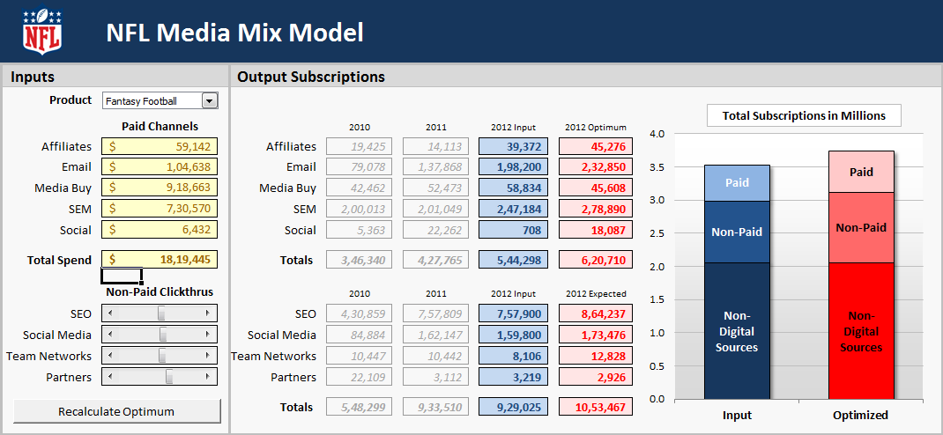
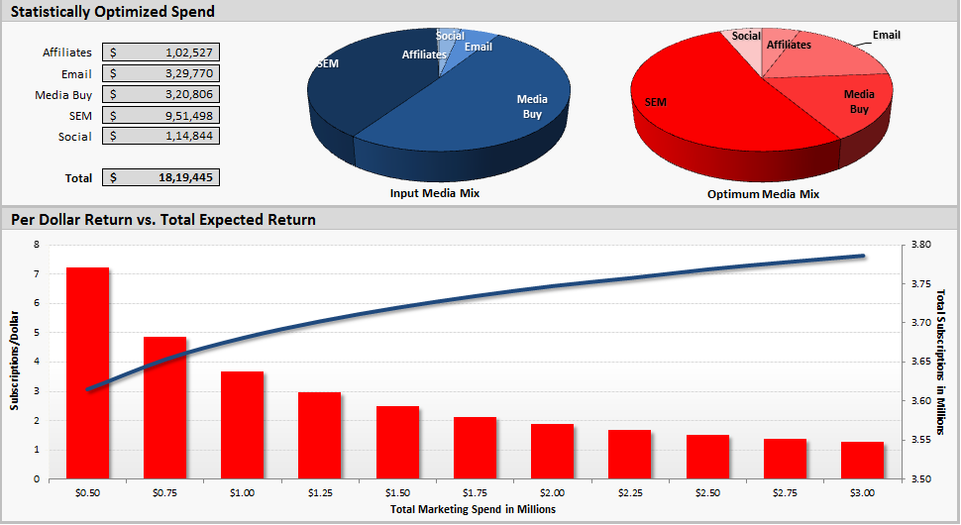
Marketing Spend Optimization- Media Mix Modelling
Insights
Business Objective
LatentView’s Solution
Business Benefits
Client is a top Professional Football League
Client’s advertising spends are spread across media vehicles to acquire more fans for their fantasy league
Identify the drivers of subscription at each subscription level, media wise saturation levels and build a model to optimally allocate media to maximize subscriptions
Attribute direct impact to each Ad spend.
Regression models were built across media using the IDV as the Transformed spends and subscriptions as the Dependent Variable (DV).
Optimizer would then iteratively allocate advertising dollars across different media vehicle based on the maximum subscriptions at each iteration
The Marketing team could use the predictive models to optimally allocate budgets to maximize subscriptions and increase engagement at a lower cost
The predictive models have been embedded in an user-friendly Excel Optimization Interface that will help the client to obtain the optimal spend allocation for a specific time period

Slide 8


Case Study: Identification of Snack Trends for New Product Launch
SOCIAL MEDIA LISTENING
DIMENSIONS OF ANALYSIS
CONVERSATION TREND MAP
Snack / Food / Health blogs
Micro Blogging
Social Bookmarking
Weblogs
BUZZ VOLUME
SEARCH TREND
POPULARITY INCREASE (conversation trend)
KEY DRIVERS
FOOD ASSOCIATIONS
SENTIMENTS
BENCHMARK TRENDS – LAST YEAR
DEEP DIVE ANALYSIS
Business Objective
LatentView’s Solution
Benefits
For leading CPG client,
To identify the “Snack Trends” worth pursuing from Social media buzz
Dimensions of Snack Trends :
Popularity Analysis:
Stay close to the emotions and excitement of consumers
Early indication of bubbling trends to increase competitive advantage
Sharpen the focus for Primary Research just on the flavors which has an increasing trend of buzz
Time to market is shortened
There is very little geographical or demographic bias as compared to traditional methods
Buzz Volume , Search Trend & Popularity Increase – was compared against that of the trends of the past year which were productionalized.
Deep Dive Analysis of Trends
Flavors
Ingredients
Key Drivers & Characteristics of the Trend
Most associated food/snacks with the flavor/ingredient/packaging/processing style trend
Sentiments attached with the trends
Processing Style
Packaging

Slide 9





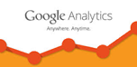
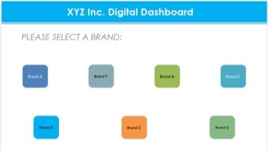



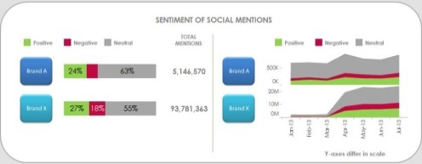
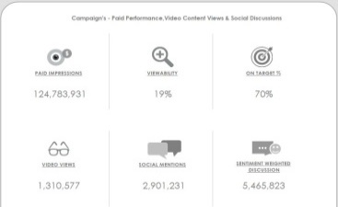
Case Study: Digial Metrics Data Platform
Business Context
LatentView Solution
Business Benefits
Single-viewed automated real-time application that enables CXOs to make quick data-driven insights from a company’s digital & social marketing efforts that cut across their Paid, Earned & Owned media spectrums.
Integrated data from five different data sources and built 11 comprehensive interlinked dashboards that give both a snapshot view and a deep dive view of their trademarks’/brands’ online presence, content marketing messages, customer perception and campaigns’ performance within their portfolio & against their competitors.
Automated real-time business intelligence application provided the client an opportunity to view their brands’ social & digital marketing efforts in visually appealing & feature-rich Tableau dashboards.
Automated
Integrated system
Enterprise
Architecture
-based reporting system
Key metrics:
Flat Files
ETL
Historical data
Content marketing - Likes, Posts, retweets, re-pins, comments etc.,
Web traffic & audience engagement - Site visits, Sessions, Session duration, Page visit depth etc.,
Video ad – Views, Viewer growth, Subscribers, likes, dislikes etc.,
Paid campaign – Impressions, Viewability rate etc.,
Social buzz – Mentions, brand sentiments etc.,
API
Extraction
Transformation
Loading
API
API
To dashboards
API
Meta data
Raw data
Summary data
Data Sources
Staging tables
Data mart
Extraction
Warehouse
Presentation

Slide 10


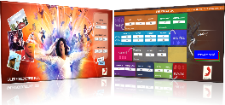







Sales Prediction
For a Global Recorded Music Company
Multivariate
Regression
Forecast Simulation Tool
Artist
Artist
Social
Media
Data
Models to forecast First Week Album Sales
Ensembling
Business Objective
LatentView Solution
Business Benefits
Key Parameters :
Artist past performance,
Social media activities (Buzz, Shares, Likes)
Listenership across channels
Prediction accuracy of up to 97% for 133 Artists across 10 Genres which can potentially increase revenue by reducing lost sales.
Decide on number of albums to work on in a given year to maintain and improve the market share.
Better time promotional activities and tours and optimize marketing spend.
Forecasting first week album sales for a music corporation to help maximize profits through outlets and also help devise a plan to improve future market share.
Measure the marketing effectiveness of various marketing and promotional activities on the first week sales.
Built an ensemble of predictive models to forecast first week sales for robustness
Analyzed and quantified the impact of various marketing efforts on first week sales
“ Vevo and YouTube views are significantly correlated to first week sales and therefore it is recommended to focus on pre-release activities on these platforms “
Notes:
10
--Abhishek Dokania
Video games sales
New technology product launch
Entertainment Industry (viewership, maganize readership)
Concert & Event ticket sales

Slide 11




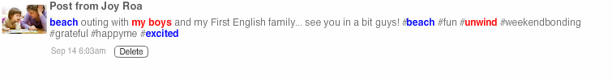

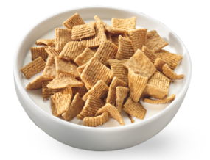
Case Study:
Opportunity Spaces: Social Media Analysis
Opportunity Space
To create a mutually exclusive and collectively exhaustive list of Opportunity Spaces. The Opportunity Spaces are mapped through an in-depth understanding of consumer choices and interaction patterns of these choices with product categories.
+
=
Opportunity Space
Analysis
Survey
Social Media Conversations
Outcome
Gives universal understanding of consumer preferences, answering questions at a broader level
Targeted insights providing a quantified imagery of the field of interest
Optimized brand imagery and messaging
High impact marketing decisions
Healthy
Functional Benefits
Home
Spatial Connect
Accompanied By
Feeling
Location
Why
Tasty
Product Attributes
Happy
Emotional Connect
Challenges: Reach -- Geographic Bias – Temporal Bias – Cognitive Bias
Granular view of the areas identified through survey and independent validation
Quantitative drill down of Brand attributes
Sample Size - Limited
Content - Questionnaire Specific
Content Relevance - High at a broad level
Sample Size - Large
Content - All public conversations
Content Relevance - High at a granular level
User generated conversations on social media once analyzed in-depth give an unbiased perspective and add value to survey results
Confidential

Slide 12




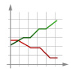




Predicting transaction fraud for a leading credit card company
Utilizing Cloud Computing Capabilities
EC2, S3
Redshift
R
Transaction Details
Authorization Data
Non-monetary Interactions – eg. change in account characteristics
Predictive models on 200 random samples
Model 1
Validation
Data
Data Profiling
Ensembling
Model 2
Validation
2 TB of data
2 billion transactions
Very low event rate - 0.15%
.
.
.
.
.
.
.
.
Challenge
Model n
Validation
Business Objective
LatentView Solution
Business Benefits
LatentView, as a trusted partner of a leading cloud services provider, utilized its cloud computing capabilities to process data pertaining to billions of transactions.
Built an ensemble of predictive models by combining the prediction from multiple models that are trained on randomly picked samples. The trained models are tested on the validation base of randomly picked non overlapping sample sets to ensure model robustness.
LatentView’s solution, helped the client to minimize the losses by catching fraud more rapidly.
Predicted 44% of fraud transactions and 45% of fraud transaction amount resulting in significant cost savings.
A leading credit card company wanted to:
Predict “Fraudulent Transactions” by analysing patterns based on current characteristics and historical purchase behaviours.

Slide 13




HALLMARK IMPLEMENTATION
Objective
Requirements
Solution
Run an email campaign targeting consumers using available segments such as gender, age, occupation, etc.
Understand consumers’ buying behavior and preferences to identify products that the consumer is likely to buy.
Make the solution dynamic to account for changing consumer preferences.
Make a personalized solution that can understand preference nuances at an individual level.
Collaborative filtering based recommendation engine
Recommend products that the consumer is likely to buy but has not bought before.
Massively scalable to calculate recommendations quickly at the click of a button for millions of consumers.
Database
Demographics based user Segmentation (Gender, Age, Occupation, KOC Membership, etc )
Transaction based Collaborative Filtering
Business rules integration
Custom prioritization based on APV value, availability, etc
Vertical specific filtration
Behavioural data
Transaction details (online + offline)

Slide 14
Ad Wear-In Analysis for a Leading Software Giant
Business Objective
LatentView’s Solution
Business Benefits
The business group wanted to understand the impact of TV advertising and how the Advertising efforts (TRPs) on Ads impact Recognition and role down across the funnel metrics.
Also, understand what is the optimal TRPs required to make an Ad have maximum reach? And understand the optimal weekly TRPs?
LatentView approached the problem in a phased manner which comprises of the following steps:
Studied the relationship between TRPs & Recognition to determine the amount of TRPs where saturation occurs
Studied the impact of Ads with same TRPs and different airing in order to determine optimal TRPs per week
Helped the client understand that:
Identified the right number of TRPs for an Ad that would reach the target recognition of ~55%
Optimal Recognition patterns were provided – for example, TRPs are spread over weeks rather than concentrated on a single week. Optimal around 75 -100 per week for an Ad with 2-3 Ad combinations per week.
Cumulative TRPs vs. Ad Recall - ~500 TRPs for an Ad would be optimal post which it saturates
No more than 2-3 Ads at the same time: Ad Recall increases with each additional Ad up to 3 Ads
Avg. Weekly TRPs vs. Ad Recall – Optimal support per week is around 75 – 100 TRPs per Ad
Ads with ~300 TRPs spread across 3-4 weeks
Ads with ~300 TRPs concentrated on 1-2 weeks

Slide 15


Opportunity Space study for New Product Launch
Business Objective
LatentView’s Solution
Business Benefits
To create a mutually exclusive and collectively exhaustive list of Opportunity Spaces.
Opportunity Spaces are mapped through an in-depth understanding of consumer choices and interaction patterns of these choices with product categories.
User generated conversations on social media once analyzed in-depth can generate an unbiased perspective and add value to survey results
Surveys:
To gain overall understanding of consumer preferences, answering questions at a broader level
Social Conversation Analysis:
To obtain granular view of the areas identified through survey and independent validation
Targeted insights providing a quantified imagery of field of interest
Optimized brand imagery and messaging
High impact marketing decisions
Quantitative drill down of brand attributes
SURVEY
SOCIAL CONVERSATION LISTENING
QUANTITATIVE DRILL DOWN
Sample Size - Limited
Content - Questionnaire Specific
Content Relevance - High at a broad level
Challenges – Reach, Geographic Bias, Temporal Bias, Cognitive Bias
Sample Size - Large
Content - All possible dimensions
Content Relevance - High at a granular level
Tasty
Product Attributes
Home
Spatial Connect
Healthy
Functional Benefits
Happy
Emotional Connect
Accompanied By
Feeling
Location
Why
Notes:
--Gnanadeepan
Brand equity measurement through social media – for existing products

Slide 16
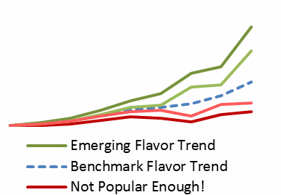
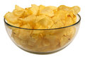
Identification of emerging snack trends for New Product Development
Business Objective
LatentView’s Solution
Business Benefits
A leading CPG client was looking -
To identify the “Snack Trends” worth pursuing from Social media buzz
Dimensions of Snack Trends that were dominant in conversations
Popularity Analysis:
Key insight - Stay close to the emotions and excitement of consumers
Early indication of bubbling trends increased competitive advantage
Sharpened the focus for Primary Research on the flavours with an increasing trend of buzz
Time to market for new flavours was shortened
Buzz Volume , Search Trend & Popularity Increase for new snacks was compared against historical trends for snacks which were productionalized
Deep Dive Analysis of Trends
Key Drivers & Characteristics of the trend
Most associated food/snacks with the flavor/ingredient/packaging/processing style trend
Sentiments attached with the trends
Flavors
Ingredients
Processing Style
Packaging
SOCIAL MEDIA LISTENING
DIMENSIONS OF ANALYSIS
CONVERSATION TREND MAP
DEEP DIVE ANALYSIS
Snack / Food / Health blogs
Micro Blogging
Social Bookmarking
Weblogs
KEY DRIVERS
Buzz volume
Search trend
Popularity increase (conversation trend)
FOOD ASSOCIATIONS
SENTIMENTS
BENCHMARK TRENDS – LAST YEAR

Slide 17
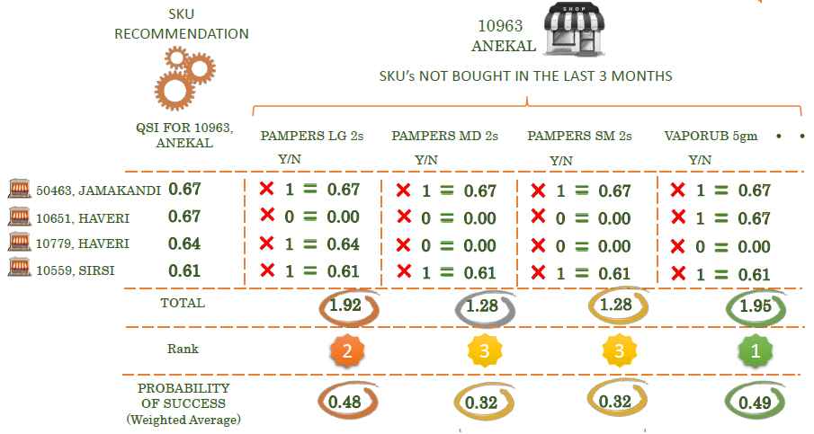








Recommendation engine for SKU replenishment in Supply Chain
Business Objective
LatentView’s Solution
Business Benefits
Recommender engine to suggest best SKUs to retail outlets for an FMCG giant, and identify next best Sub-brand-form to recommend for each store subject to the following conditions:
Not purchased by the store in last three months
Multiple suggestions per store (top 3 or 1 per category).
Probability score for each suggestion
Segmentation:
Collaborative Filtering based recommendation engine
Captures seasonality, product affinity and consumer behaviour
Customizes the recommendation to the target store
Improves the effectiveness of the salesforce
Clustering of similar stores based on channel type and store size.
Collaborative Filtering:
Identification of nearest neighbours for each store based on similarity score, using Jaccard’s Index
Rank ordering of SKUs bought by nearest neighbours (not a part of base order)
Recommendation of top 3 SKUs to target store.
1
Segmentation
2
Similarity Index
Calculator
3
4
Target Store
Store Type 1
Target Store
Store Type n..
Store Level SKU Recommendation
Similar Stores
Store Type 2

Slide 18











Predicting future demand for Beverages at SKU level
MATURED SKUS
NEW SKUS
Historical Sales Data
Seasonality
Annual Operating Plan
Correlation study to identify clusters
Historical
Monthly Data
SKU Pattern
Forecasted Values
Time Series Forecasting Algorithm
YoY / MoM
Growth
Production
Pattern
Clustered Data
Time-series model predict sales
Better estimation of demand enables improved production and supply-chain management - resulting in overall optimization of the resources
Better inventory planning in warehouses reduces cost of carrying goods and occasions of stock-out
Calculate forecast accuracy
Forecasted Sales
Forecast Accuracy Reports
Notes:
“Companies that do a better job of predicting future demand can often cut 20 to 30 percent out of inventory, depending on the industry, while increasing the average fill rate by 3 to 7 percentage points. Such results can generate margin improvements of as much as 1 to 2 percentage points.”
- https://www.bcgperspectives.com/content/articles/technology_making_big_data_work_supply_chain_management/

Slide 19
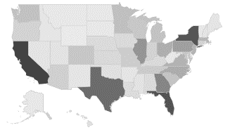

Daily Demand Forecasting for a US based Retail Major
ARIMA,
Neural Networks
ARIMAX
Statistical Techniques
ZIP Code
Product Category
Payment Method
Historical Call Centre Data
Segmentation Types
Business Objective
LatentView’s Solution
Business Benefits
Client is a one of the largest Retailer who provides End-to-End solutions including after-sales services
There is a fluctuating demand pattern for Service Orders on Daily Basis. The client wants Daily Demand forecasts to:
Avoid over-staffing, and
Allocate resources optimally with least Response Time
Classify the Historical data by Geography, Product Category, Customer types
Run Modeling using different techniques: ARIMA, ARIMAX, ETS, Neural Networks
Use the best results based on the overall accuracy of the model generated
Deliver the Forecasts for the next 18 Months, at a daily level
Enables to analyse the patterns and seasonality of demands at a deeper level
Optimal supply of Technicians helps to reduce the cost of overstaffing
Helps to plan for specific- Geography, Product Category and Customer Types
Used in budgeting, planning and procurement of resources

Slide 20



Enhancement of Parts Supply Chain for Services for a US based Retail Major
Tracks the Time (in days) for completion of Parts Delivery
Provides a holistic view of the Progress towards the goal
SLICE DOWN THE SUPPLY CHAIN
CYCLE TIME TRENDS
Statistical Tools
IDENTIFY THE KEY METRICS
Shows Time (in days) for various stages in procuring parts
Helps to track patterns using Gantt Charts
Parts CYCLE TIME
Input data and KPIs
ANALYZE METRICS FROM MULTIPLE PERSPECTIVES
Parts Cycle Time
Transit Time
Parts Availability Usage
Transit Time
Provides a snapshot of # Parts available vs # Parts used
Tracking of Various Channels & their efficiency
PRODUCE ACTIONABLE INSIGHTS
CYCLE TIME TRENDS
Business Objective
LatentView’s Solution
Business Benefits
Client is one of the largest retail companies and has both online and physical stores.
Based on Customer Service Orders, the client provides its repair services through technicians, at customer’s location
The client wants to complete 95% of Customer Service Orders in 5 days and this requires enhancing the supply chain
Break down the entire supply chain into segments and understand the flow
Deep dive into the delivery mechanism and analyze the various dimensions
Produce detailed KPIs with respect to geography, product category, revenue etc. so that the insights can be implemented readily
Track the end to end supply chain
Easy to identify the pain points and implement fixes
Focus on the geographies with great market potential that need special attention
Quicker deliveries resulted in minimizing inventory storage requirements

Slide 21
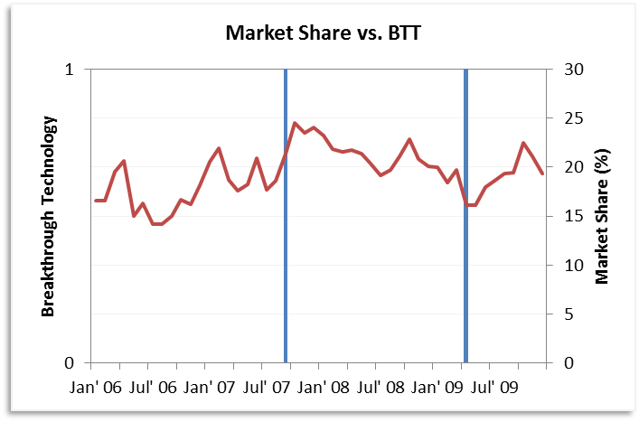
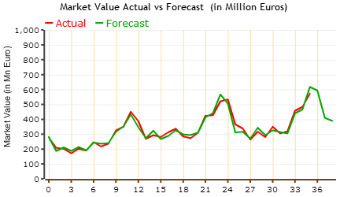
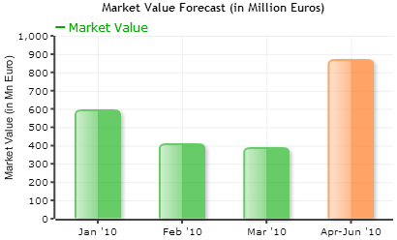
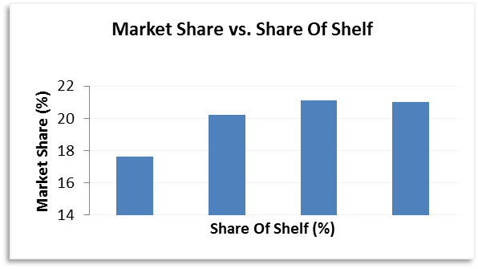
Market Share and Market Value Models built for a Europe based CPG Major
Market Share Model
Market Value Model
Input variables
Key Findings
Input variables
Key Findings
Price
Product Introductions
Breakthrough Technology
Net Promoter Score
Online market share
Past Sales
Macroeconomic Data
Consumer Expenditure
New Product Introductions
Breakthrough Technology
Big Event (Promotions)
 | Product Introductions
 | BreakThrough Tech
 | Share of Voice
 | Share of Shelf
 | Net Promoter Score
 | Competitor Product Into
 | Market Value (Lagged)
 | Media Market Promotions
 | GDP growth
 | Current GDP
 | World Cup
 | Unemployment Rate
Business Objective
LatentView’s Solution
Business Benefits
Client is one of the leading consumer electronics companies with both offline & online presence.
Develop Market Trend and Market share models for the client using monthly data
Generate predictions on Overall market value and client’s market share for the next 6 months
LatentView adopted a “layered modeling” approach
Initially developing a baseline model (ARIMA)
Refining the model with additional data (Macroeconomic and Market Events)
High accuracy in predictions
5% MAPE for Market Value models (9% MAPE with baseline ARIMA)
± 4% Error rate for Market share models
Understanding drivers and studying their effect on Market Value and Share

Slide 22

Demand Forecasting for a Leading Beverage Manufacturer
Correlation study to identify clusters
Time-series model to predict sales for each segment
Calculate forecast accuracy
Historical Sales Data
Clustered Data
Forecasted Sales
Forecast Accuracy Reports
Business Objective
LatentView’s Solution
Business Benefits
Develop demand forecasting models that would predict the demand for the immediate three months at the unit-brand pack level
Support the demand planning team with their regular monthly reports and ad-hoc analysis
Correlation was performed to identify clusters
Models were built using techniques like ARIMA and Linear Regression to forecast the demand for the immediate three months
The forecasted values were compared against the actual values and various reports were generated on a monthly basis to address gaps/deviations if any
Better understanding and estimation of demand enabling, improved production and supply-chain management - resulting in overall optimization of the resources
Provides better inventory planning in the warehouses thus reducing the cost of carrying goods and also avoid stock-outs

Slide 23
Inventory Metrics Measurements and Reporting for a leading Beverage Manufacturers
Levels of Granularity
Identifying Insufficient and Excess Inventory
Set and Refresh Inventory Targets
Analysis of Improvement Scenario
Sector/Sub Sector/Country
Material Attributes
Business Segments
Brands
SKU
Supply Chain Health
Inventory Analysis
SKU Analysis
Component Overview
Safety Stock Analysis
Cycle Stock Analysis
In Transit Analysis
Pre-Build Analysis
Scenario Analysis
Goal Setting Analysis
What-if Analysis
Business Objective
LatentView’s Solution
Business Benefits
To provide a starting point for the analytics dimension of inventory management capabilities
To identify average excess inventory levels and set smart targets by SKU and location
To identify ‘near term’ inventory reduction opportunities
To understand key operational drivers
Dashboards were built using Tableau to provide an end to end solution illustrating the flow of Inventory for both Raw Materials and Finished Goods
A logical flow of dashboards was built which provided a holistic snapshot of the supply chain network , capturing the key governing parameters from a sector level to an SKU level
Developed a What-If analysis framework providing the user a platform to simulate different scenarios and hence identify the optimal method to reduce excess inventory.
Provides better inventory planning in the warehouses thus reducing the cost of carrying goods and also avoid stock-outs
Identifies the opportunities for improvement from a Sector level up to a SKU location level using the key performance indicators for various inventory components

Slide 24

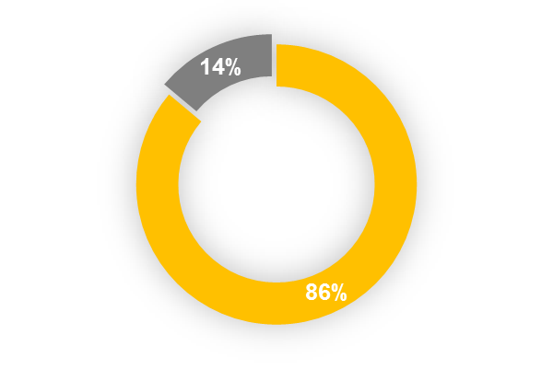



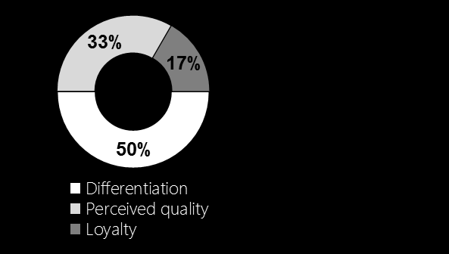






PepsiCo Equity Modelling
How significant is the contribution of Brand Equity in driving sales across the globe ?
Business Objective:
To determine the significance and the impact of brand equity on sales at a brand-country level and recommend which brands / countries should invest in tracking brand equity
Overview of results
In matured Markets like USA, fluctuations in sales is not related to the brand equity
Tracking brand equity is significant only for Beverages and not Snacks brands
Brand Equity Components
which matter the most
In developing markets
Benefits and Business Impact:
A better understanding of what drives sales in different countries for individual brands
Improved bottom line by cutting down the unnecessary expenditure in assimilating monthly brand equity surveys across the geographies
It translates to sales only in Developing Markets like India, China, Mexico etc.
Brand equity is major contributor of sales only in 14% of the markets *
What might correlates with sales apart from Brand equity ?
Advertisement -Digital Media, Print, TV
Distribution in stores and product availability
LatentView’s approach:
* Analyzed 36 brand-country combinations (snacks and beverages) across different market types
Monthly Data Aggregation
Brand equity survey
Media spend
Distribution pattern
Pricing information
Survey results aggregation:
Loyalty
Awareness
Perceived quality
Differentiation
Results for each brand-country combination:
Result 1
Result 2
..
Result n
Correlation & Exploratory analysis
Bucketing and summarizing the individual brand-country results
Market and Brand level Insights
Regression & Hypothesis Testing

Slide 25


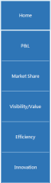
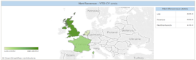
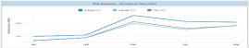
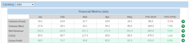






Leading Beverage Company – Harmonized Performance Management Measurement
Define KPI’s which will comprise the global scorecard and will serve as the global standard across sectors, regions and markets
Enterprise DW
Business Objective
Filtering Right KPI’s
Created a visually represented automated report comprised of global KPI’s based on existing data in the enterprise data warehouse (EDW.)
Built dashboards across the functions like Finance, Marketing, Operations, Innovations & Quality Control with the use of best practices in designing dashboards.
KPI hierarchy of importance
The flow of content
Comprehensive look/view to drive decision making
Dashboard
Designing
Story Boarding
Enhance visual clarity
Inter- active
Choose right Visuals
Maintain Visual Hierarchy
Keep Dashboards Consistent, Contextual and Uncluttered
Enforce Comparisions
Integrate text, graphics and data
Type of Visual:
Time Series - Discrete or continuous patterns over time
Proportions - Categorical, parts of whole, or over time
Relationships - Correlations, distributions, comparisons
Spatial Relationships - Regions, specific locations, or over time
LatentView Solution
Enable users to perform basic analytical tasks such as filtering views & drilldown
The BI layer helps monitor progress against the company’s financial objectives & compare common metrics across sectors/regions/markets in order to identify areas for optimization
The BI layer is the consolidation of metrics across functions which helps client in strategic decision making
Business Benefits
Marketing
Quality Control
Finance
Operations
Innovations
CxO

Slide 26





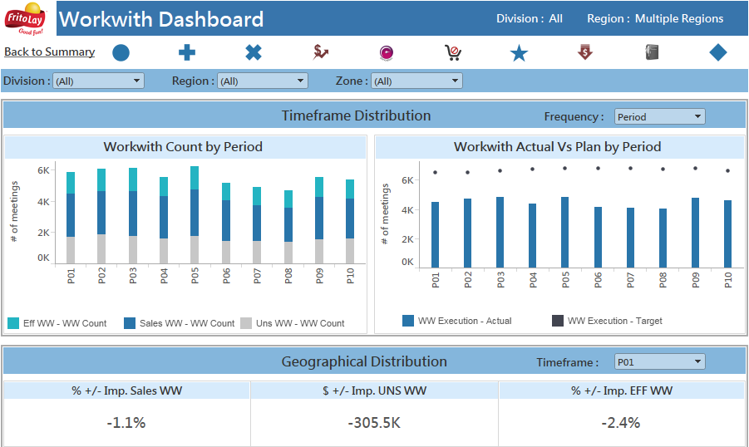

Go To Market Visualization Dashboard Case
Business Objective
To track overall business metrics and rank performance using scorecards.
To monitor the performance of Route Sales Representatives, the mismatches in shipping and the impact of meetings.
Sales
Efficiency
Performance of representative
Effect of metric on meeting
Shipping Audit
MSSQL
Using Java to consolidate data into single source
Levels of Granularity
Division / Region / Zone / District
Route / Customer
Order
Item
Access DB
Distribution Leaders
HIVE
Business Benefits
Identifies the flaws in each sector and provides the areas for improvement.
Determines the impact of individual metrics on business.

Slide 27

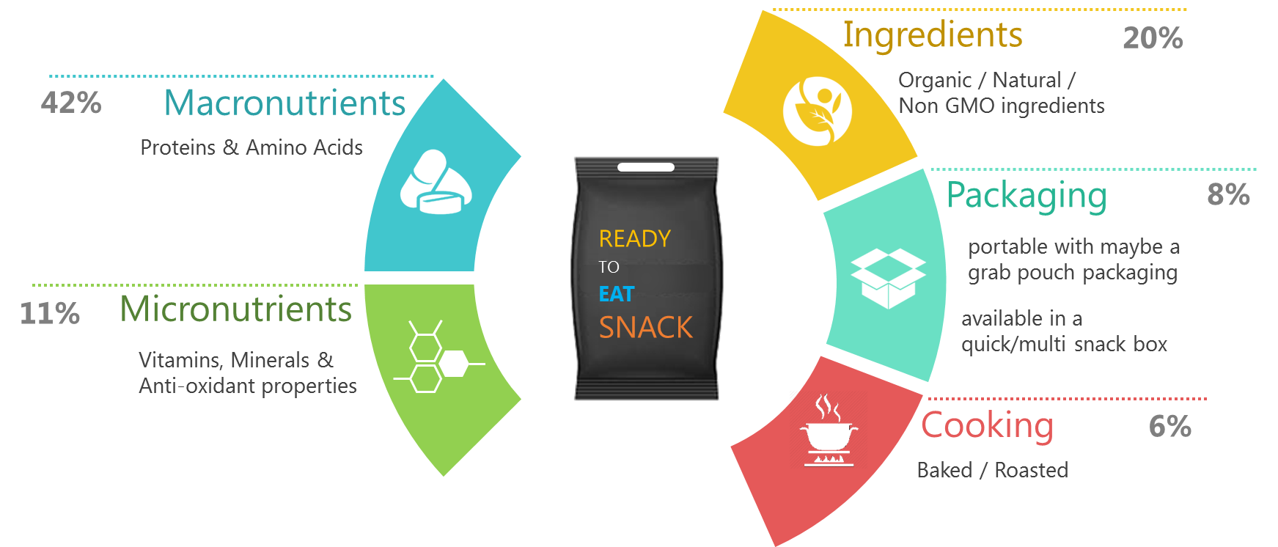






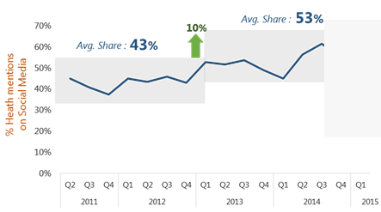
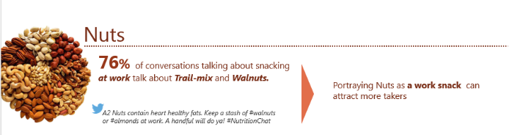



Case Study
Analysis of Healthy Snacking needs from Social media
OBJECTIVE
SOLUTION
BENEFITS
Understand the shift in consumer behavior towards healthier snacking habits using social media analytics
Key Needs that were identified from text mining social conversations
Media Sources
Healthy
Lifestyle
Energize & Replenish
Curb Hunger & Temptation
*Nielsen’s 2015 Global Health & Wellness Survey
Product Innovation Cues
Key Insights derived for the Consumer Insights team
Mothers were substituting their kids snacks with healthier options like yoghurt, fruits, nuts
Who
Consumers were discussing how to manage late night ‘guilty snacking’
When
Preventing illnesses and improving immunity by consuming appropriate ingredients
What
Marketing Cues
10

